Slide 1
11 - Construction Grammar
Nick Riches
Homework
11 - Construction Grammar
(Verbs in the passenger seat)
Probs with trad accs
Val.Aug.
Weird Them.rels
A solution
Goldberg’s theory Valency aug Weird them.rels
Nick Riches
Combination
Fusion Trad roles
Newcastle University
Implications
Words and rules account Construction Grammar
December 12, 2018
Other constructions
Comparing the two models
Comparison
Probs for CG Clin Imps
Bibliography
1 / 34

Slide 2
11 - Construction Grammar
Homework
Problems with traditional Verb Argument Structure accounts
Nick Riches
Homework
Probs with trad accs
Val.Aug.
Weird Them.rels
How constructions solve these issues How constructions combine with verbs The implications of VAS constructions
A solution
Goldberg’s theory Valency aug Weird them.rels
Combination
Fusion Trad roles
Other types of construction (not VAS)
Implications
Words and rules account Construction Grammar
Comparing the two models
Other constructions
Problems for construction grammar
Comparing the two models
Comparison
Clinical implications
Bibliography
Probs for CG
Clin Imps
Bibliography
1 / 34

Slide 3
11 - Construction Grammar
Nick Riches
Homework
Probs with trad accs
Val.Aug.
Weird Them.rels
A solution
Goldberg’s theory Valency aug Weird them.rels
1. She sneezed the napkin off the table
Combination
Fusion Trad roles
Implications
Words and rules account Construction Grammar
Other constructions
Comparing the two models
Comparison
Probs for CG
Clin Imps
Bibliography
2 / 34

Slide 4
11 - Construction Grammar
Nick Riches
Homework
Probs with trad accs
Val.Aug.
Weird Them.rels
Special sense of sneeze, e.g. sneeze = make a sudden involuntary expulsion of air from the nose and mouth due to irritation of one’s nostrils such that the resulting air flow propels an object X from location Y.
The meaning comes from the construction
A solution
Goldberg’s theory Valency aug Weird them.rels
Combination
Fusion Trad roles
Implications
Words and rules account Construction Grammar
Other constructions
Comparing the two models
Comparison
Probs for CG Clin Imps Bibliography
3 / 34

Slide 5
11 - Construction Grammar
Nick Riches
Homework
Probs with trad accs
Val.Aug.
Weird Them.rels
A solution
Goldberg’s theory Valency aug Weird them.rels
(1) She sneezed the napkin off the table
S VERB Od PP
Subject acts on object in such a way that the object
changes location
Combination
Fusion Trad roles
Implications
Words and rules account Construction Grammar
Other constructions
Comparing the two models
Comparison
Probs for CG Clin Imps Bibliography
4 / 34

Slide 6
11 - Construction Grammar
Nick Riches
Homework
Probs with trad accs
Val.Aug.
Weird Them.rels
A solution
Goldberg’s theory Valency aug Weird them.rels
By assuming that constructions have meaning, we can overcome a lot of problems with traditional Verb Argument Structure accounts.
Combination
Fusion Trad roles
Implications
Words and rules account Construction Grammar
Other constructions
Comparing the two models
Comparison
Probs for CG Clin Imps
Bibliography
5 / 34

Slide 7
11 - Construction Grammar
Homework
Problems with traditional Verb Argument Structure accounts
Nick Riches
Homework
Probs with trad accs
Val.Aug.
Weird Them.rels
How constructions solve these issues How constructions combine with verbs The implications of VAS constructions
A solution
Goldberg’s theory Valency aug Weird them.rels
Combination
Fusion Trad roles
Other types of construction (not VAS)
Implications
Words and rules account Construction Grammar
Comparing the two models
Other constructions
Problems for construction grammar
Comparing the two models
Comparison
Clinical implications
Bibliography
Probs for CG
Clin Imps
Bibliography
5 / 34

Slide 8
1. Valency augmentation
11 - Construction Grammar
Nick Riches
Homework
Probs with trad accs
Val.Aug.
Weird Them.rels
1. She sneezed the napkin
off the table
A solution
Goldberg’s theory Valency aug Weird them.rels
2. The naughty students laughed the teacher
out of the room
Combination
Fusion Trad roles
3. She juggled her way
to the semi-finals of the juggling contest
Implications
Words and rules account Construction Grammar
4. Can you chop some carrots?
me
5. Quote me ! (Recent advert for insurance)
happy
Other constructions
Comparing the two
models
Comparison
Probs for CG
Clin Imps
Bibliography
6 / 34

Slide 9
2. Weird thematic relations
11 - Construction Grammar
Nick Riches
Homework
Probs with trad accs
Val.Aug.
Weird Them.rels
There are plenty of verbs which take arguments with ‘weird’ roles, e.g.
A solution
Goldberg’s theory Valency aug Weird them.rels
1. She is happy
Combination
Fusion Trad roles
Implications
Words and rules account Construction Grammar
Other constructions
Comparing the two
models
Comparison
Probs for CG
Clin Imps
Bibliography
7 / 34

Slide 10
2. Weird thematic relations
11 - Construction Grammar
Nick Riches
Homework
Probs with trad accs
Val.Aug.
Weird Them.rels
There are plenty of verbs which take arguments with ‘weird’ roles, e.g.
A solution
Goldberg’s theory Valency aug Weird them.rels
She is happy
The table needs a leg
Combination
Fusion Trad roles
Implications
Words and rules account Construction Grammar
Other constructions
Comparing the two models
Comparison
Probs for CG Clin Imps Bibliography
7 / 34

Slide 11
2. Weird thematic relations
11 - Construction Grammar
Nick Riches
Homework
Probs with trad accs
Val.Aug.
Weird Them.rels
There are plenty of verbs which take arguments with ‘weird’ roles, e.g.
A solution
Goldberg’s theory Valency aug Weird them.rels
1.
2.
3.
She is happy
needs a leg suits you
Combination
Fusion Trad roles
The table
That coat
Implications
Words and rules account Construction Grammar
Other constructions
Comparing the two models
Comparison
Probs for CG Clin Imps Bibliography
7 / 34

Slide 12
2. Weird thematic relations
11 - Construction Grammar
Nick Riches
Homework
Probs with trad accs
Val.Aug.
Weird Them.rels
There are plenty of verbs which take arguments with ‘weird’ roles, e.g.
A solution
Goldberg’s theory Valency aug Weird them.rels
1.
2.
3.
4.
is happy
She
The table
That coat
The coat
needs a leg suits you
Combination
Fusion Trad roles
Implications
Words and rules account Construction Grammar
fits me
Other constructions
Comparing the two models
Comparison
Probs for CG Clin Imps Bibliography
7 / 34

Slide 13
2. Weird thematic relations
11 - Construction Grammar
Nick Riches
Homework
Probs with trad accs
Val.Aug.
Weird Them.rels
There are plenty of verbs which take arguments with ‘weird’ roles, e.g.
A solution
Goldberg’s theory Valency aug Weird them.rels
1.
2.
3.
4.
is happy
She
The table
That coat
The coat
needs a leg suits you
Combination
Fusion Trad roles
Implications
Words and rules account Construction Grammar
fits me
5. She swapped her Porsche for
a Ferrari
Other constructions
Comparing the two
models
Comparison
Probs for CG
Clin Imps
Bibliography
7 / 34

Slide 14
2. Weird thematic relations
11 - Construction Grammar
Nick Riches
Homework
Probs with trad accs
Val.Aug.
Weird Them.rels
There are plenty of verbs which take arguments with ‘weird’ roles, e.g.
A solution
Goldberg’s theory Valency aug Weird them.rels
1.
2.
3.
4.
is happy
She
The table
That coat
The coat
needs a leg suits you
Combination
Fusion Trad roles
Implications
Words and rules account Construction Grammar
fits
me
her Porsche |  |  | for | a Ferrari
he truck |  | with hay
5. She swapped
Other constructions
6. They loaded t
Comparing the two
models
Comparison
Probs for CG
Clin Imps
Bibliography
7 / 34

Slide 15

2. Weird thematic relations
11 - Construction Grammar
Nick Riches
Homework
Dozens of attempts by linguistics to come up with a definitive list!
Probs with trad accs
Val.Aug.
Weird Them.rels
A solution
Goldberg’s theory Valency aug Weird them.rels
Combination
Fusion Trad roles
Implications
Words and rules account Construction Grammar
Other constructions
Comparing the two
models
Comparison
Probs for CG
Clin Imps
Bibliography
8 / 34

Slide 16
11 - Construction Grammar
Homework
Problems with traditional Verb Argument Structure accounts
Nick Riches
Homework
Probs with trad accs
Val.Aug.
Weird Them.rels
How constructions solve these issues How constructions combine with verbs The implications of VAS constructions
A solution
Goldberg’s theory Valency aug Weird them.rels
Combination
Fusion Trad roles
Other types of construction (not VAS)
Implications
Words and rules account Construction Grammar
Comparing the two models
Other constructions
Problems for construction grammar
Comparing the two models
Comparison
Clinical implications
Bibliography
Probs for CG
Clin Imps
Bibliography
8 / 34

Slide 17
Goldberg’s (1995) theory of Verb Argument Structure Constructions
11 - Construction Grammar
Nick Riches
Homework
Probs with trad accs
Val.Aug.
Weird Them.rels
A solution
Goldberg’s theory Valency aug Weird them.rels
When we use verbs in sentences, we insert them into Verb Argument Structure Constructions (VAS Constructions).
These are syntactic units with their own independent meaning.
Combination
Fusion Trad roles
Implications
Words and rules account Construction Grammar
Other constructions
Comparing the two models
Comparison
Probs for CG
Clin Imps
Bibliography
9 / 34

Slide 18
Goldberg’s (1995) theory of Verb Argument Structure Constructions
11 - Construction Grammar
Nick Riches
Homework
Probs with trad accs
Val.Aug.
Weird Them.rels
A solution
Goldberg’s theory Valency aug Weird them.rels
(1) S
he | sneezed |  | the napkin |  | off the table
S | VERB |  | Od |  | PP
Combination
Fusion Trad roles
Subject acts on object in such a way that the object changes location
Implications
Words and rules account Construction Grammar
Other constructions
Comparing the two models
Comparison
Probs for CG Clin Imps Bibliography
10 / 34

Slide 19
Valency augmentation
11 - Construction Grammar
Nick Riches
Homework
Probs with trad accs
Val.Aug.
Weird Them.rels
A solution
Goldberg’s theory Valency aug Weird them.rels
The multiple sense account.
The construction based account.
The extra argument is specified by the construction itself.
Combination
Fusion Trad roles
Implications
Words and rules account Construction Grammar
Other constructions
Comparing the two models
Comparison
Probs for CG Clin Imps Bibliography
11 / 34

Slide 20
Weird thematic relations
11 - Construction Grammar
Nick Riches
Homework
Probs with trad accs
Val.Aug.
Weird Them.rels
A solution
Goldberg’s theory Valency aug Weird them.rels
If roles are (in part) given by the construction itself, we are not committed to a small set of roles.
Combination
Fusion Trad roles
Implications
Words and rules account Construction Grammar
Other constructions
Comparing the two models
Comparison
Probs for CG Clin Imps Bibliography
12 / 34

Slide 21
Weird thematic relations
1
great
a great Christmas film
(2)
Die hard
is
NP₁
copula
ADJ / NP₂
ADJ / NP₂ denotes a property of NP₁

Slide 22
Weird thematic relations
1
great
a great Christmas film
(2)
Die hard
is
NP₁
copula
ADJ / NP₂
ADJ / NP₂ denotes a property of NP₁
(3)
One man’s terrorist
is
another man’s freedom fighter
NP₁
copula
NP₂
Both NPs identify the same referent

Slide 23
Weird thematic relations
1
great
a great Christmas film
(2)
Die hard
is
NP₁
copula
ADJ / NP₂
ADJ / NP₂ denotes a property of NP₁
(3)
One man’s terrorist
is
another man’s freedom fighter
NP₁
copula
NP₂
Both NPs identify the same referent
(4)
George Clooney
is
George Clooney
NP₁
copula
NP₂
The individual identified by both NPs has a property which is relevant to the discussion.

Slide 24
Weird thematic relations
11 - Construction Grammar
Nick Riches
Homework
Probs with trad accs
Val.Aug.
Weird Them.rels
A solution
Goldberg’s theory Valency aug Weird them.rels
1
need
(5)
We
’re going to
a bigger boat
require
Combination
Fusion Trad roles
NP₂
^{NP1} Verb of needing
NP₁ needs NP₂
Implications
Words and rules account Construction Grammar
Other constructions
Comparing the two models
Comparison
Probs for CG Clin Imps Bibliography
14 / 34

Slide 25
Weird thematic relations
11 - Construction Grammar
Nick Riches
Homework
Probs with trad accs
Val.Aug.
Weird Them.rels
A solution
Goldberg’s theory Valency aug Weird them.rels
1
fits
(6) That dress
you
suits
Combination
Fusion Trad roles
NP₁
NP₂
verb of fitting/suiting
NP₁ looks good on NP₂
Implications
Words and rules account Construction Grammar
Other constructions
Comparing the two models
Comparison
Probs for CG Clin Imps
Bibliography
15 / 34

Slide 26
11 - Construction Grammar
Homework
Problems with traditional Verb Argument Structure accounts
Nick Riches
Homework
Probs with trad accs
Val.Aug.
Weird Them.rels
How constructions solve these issues How constructions combine with verbs The implications of VAS constructions
A solution
Goldberg’s theory Valency aug Weird them.rels
Combination
Fusion Trad roles
Other types of construction (not VAS)
Implications
Words and rules account Construction Grammar
Comparing the two models
Other constructions
Problems for construction grammar
Comparing the two models
Comparison
Clinical implications
Bibliography
Probs for CG
Clin Imps
Bibliography
15 / 34

Slide 27
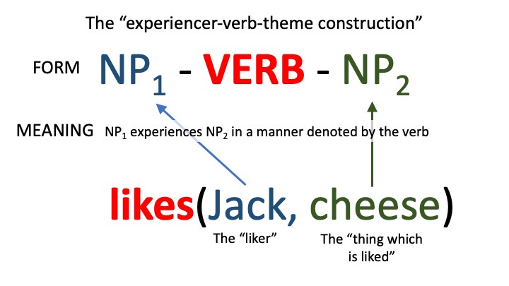
Fusion
11 - Construction Grammar
Nick Riches
Homework
Probs with trad accs
Val.Aug.
Weird Them.rels
A solution
Goldberg’s theory Valency aug Weird them.rels
Combination
Fusion Trad roles
Implications
Words and rules account Construction Grammar
Other constructions
Comparing the two models
Comparison
Probs for CG
Clin Imps
Bibliography
16 / 34

Slide 28
What about traditional roles, e.g. “AGENT” / “PATIENT”?
11 - Construction Grammar
Nick Riches
Homework
Probs with trad accs
Val.Aug.
Weird Them.rels
A solution
Goldberg’s theory Valency aug Weird them.rels
Traditional labels could be used to describe slots in VAS Constructions with very general/abstract meanings,
e.g. AGENT + VERB + PATIENT
But importantly, the roles are specified by the construction, and are not independent of it
Combination
Fusion Trad roles
Implications
Words and rules account Construction Grammar
Other constructions
Comparing the two models
Comparison
Probs for CG Clin Imps Bibliography
17 / 34

Slide 29
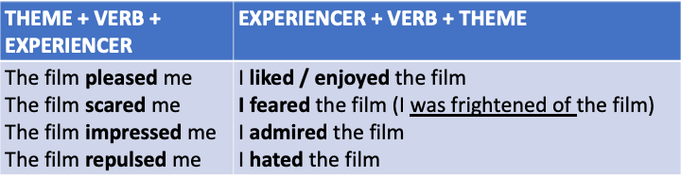
What about traditional roles, e.g. “AGENT” / “PATIENT”?
11 - Construction Grammar
Nick Riches
Homework
Probs with trad accs
Val.Aug.
Weird Them.rels
A solution
Goldberg’s theory Valency aug Weird them.rels
Some of the more general roles are ‘echoed’ across constructions...
Combination
Fusion Trad roles
Implications
Words and rules account Construction Grammar
Other constructions
Comparing the two models
Comparison
Probs for CG Clin Imps
Bibliography
18 / 34

Slide 30
11 - Construction Grammar
Homework
Problems with traditional Verb Argument Structure accounts
Nick Riches
Homework
Probs with trad accs
Val.Aug.
Weird Them.rels
How constructions solve these issues How constructions combine with verbs The implications of VAS constructions
A solution
Goldberg’s theory Valency aug Weird them.rels
Combination
Fusion Trad roles
Other types of construction (not VAS)
Implications
Words and rules account Construction Grammar
Comparing the two models
Other constructions
Problems for construction grammar
Comparing the two models
Comparison
Clinical implications
Bibliography
Probs for CG
Clin Imps
Bibliography
18 / 34

Slide 31
Words and rules account
11 - Construction Grammar
Nick Riches
The words and rules account (e.g. Chomksyan linguistics):
Homework
RULE 1
: VP ⇐ V + NP
: Sentence ⇐ NP + VP
Probs with trad accs
Val.Aug.
Weird Them.rels
RULE 2
A solution
Goldberg’s theory Valency aug Weird them.rels
Sentence
Combination
Fusion Trad roles
NP VP
Jack V NP
Implications
Words and rules account Construction Grammar
Other constructions
(7)
likes fish
Comparing the two models
Comparison
INTERPRETATION: A situation involving two NPs whose
Probs for CG
roles are determined by the verb.
Clin Imps
Bibliography
19 / 34

Slide 32
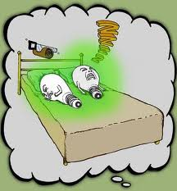
Words and rules account
11 - Construction Grammar
Nick Riches
Colourless green ideas sleep furiously
Homework
Probs with trad accs
Val.Aug.
Weird Them.rels
A solution
Goldberg’s theory Valency aug Weird them.rels
Combination
Fusion Trad roles
Implications
Words and rules account Construction Grammar
Other constructions
Comparing the two models
Comparison
Probs for CG Clin Imps
Bibliography
20 / 34

Slide 33
Words and rules account
11 - Construction Grammar
Nick Riches
Homework
Probs with trad accs
Val.Aug.
Weird Them.rels
A solution
Goldberg’s theory Valency aug Weird them.rels
Categorical distinction between syntax (combinatorial rules) and the lexicon (repository of meaning)
Combination
Fusion Trad roles
Implications
Words and rules account Construction Grammar
Other constructions
Comparing the two models
Comparison
Probs for CG Clin Imps Bibliography
21 / 34

Slide 34
Construction Grammar
11 - Construction Grammar
Nick Riches
Homework
Probs with trad accs
Val.Aug.
Weird Them.rels
Syntactic constructions can also be meaningful. No distinction between syntax and the lexicon. Words involve mapping between form and meaning.
Constructions also involve a mapping between form and meaning.
A solution
Goldberg’s theory Valency aug Weird them.rels
Combination
Fusion Trad roles
Implications
Words and rules account Construction Grammar
Other constructions
Comparing the two models
Comparison
Probs for CG Clin Imps
Bibliography
22 / 34

Slide 35
11 - Construction Grammar
Homework
Problems with traditional Verb Argument Structure accounts
Nick Riches
Homework
Probs with trad accs
Val.Aug.
Weird Them.rels
How constructions solve these issues How constructions combine with verbs The implications of VAS constructions
A solution
Goldberg’s theory Valency aug Weird them.rels
Combination
Fusion Trad roles
Other types of construction (not VAS)
Implications
Words and rules account Construction Grammar
Comparing the two models
Other constructions
Problems for construction grammar
Comparing the two models
Comparison
Clinical implications
Bibliography
Probs for CG
Clin Imps
Bibliography
22 / 34

Slide 36
11 - Construction Grammar
Nick Riches
Homework
Probs with trad accs
Val.Aug.
Weird Them.rels
A solution
Goldberg’s theory Valency aug Weird them.rels
Clip from While we’re young
Combination
Fusion Trad roles
Implications
Words and rules account Construction Grammar
Other constructions
Comparing the two models
Comparison
Probs for CG
Clin Imps
Bibliography
23 / 34

Slide 37
11 - Construction Grammar
Nick Riches
Homework
Probs with trad accs
Val.Aug.
Weird Them.rels
(8) ARTHRITIS arthritis!?
A solution
Goldberg’s theory Valency aug Weird them.rels
(9) It’s tuna salad, not SALAD-salad.
Combination
Fusion Trad roles
(10)
Is he french, or FRENCH-french?
Implications
Words and rules account Construction Grammar
(11)
Oh, we’re not LIVING-TOGETHER living-together (NB Verb Phrase is doubled)
Other constructions
Comparing the two
models
Comparison
Probs for CG
Clin Imps
Bibliography
24 / 34

Slide 38
11 - Construction Grammar
Nick Riches
Homework
Probs with trad accs
Val.Aug.
Weird Them.rels
A solution
Goldberg’s theory Valency aug Weird them.rels
ARTHRITIS arthritis!? FORM: N + N
MEANING: We evoke a scale of authenticy. N + N is placed higher on the scale than N
Combination
Fusion Trad roles
Implications
Words and rules account Construction Grammar
Other constructions
Comparing the two
models
Comparison
Probs for CG
Clin Imps
Bibliography
25 / 34

Slide 39
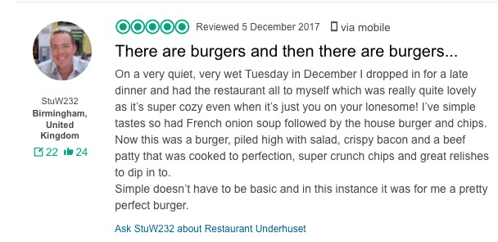
11 - Construction Grammar
Nick Riches
Homework
Probs with trad accs
Val.Aug.
Weird Them.rels
A solution
Goldberg’s theory Valency aug Weird them.rels
Combination
Fusion Trad roles
Implications
Words and rules account Construction Grammar
Other constructions
(12)
There are burgers and then there are burgers
Comparing the two models
Comparison
There is/are NP₁ and then there is/are NP₂
2nd NP is more authentic than the first
Probs for CG
Clin Imps
Bibliography
26 / 34

Slide 40
11 - Construction Grammar
Nick Riches
Homework
Probs with trad accs
Val.Aug.
Weird Them.rels
A solution
Goldberg’s theory Valency aug Weird them.rels
(13)
Now watch me go and drop this cake!
Now watch Non-finite clause
Combination
Fusion Trad roles
We are ‘tempting fate’
Implications
Words and rules account Construction Grammar
Other constructions
Comparing the two models
Comparison
Probs for CG
Clin Imps
Bibliography
27 / 34

Slide 41
(14)
She |  | worked |  | her way |  | to the top of the class
SUBJ. |  | V |  | his/her/its way |  | PREP. PHRASE
SUBJECT changes location (literally/metaphorically) by performing action denoted by the verb. Movement is effortful and circuitous

Slide 42
11 - Construction Grammar
Homework
Problems with traditional Verb Argument Structure accounts
Nick Riches
Homework
Probs with trad accs
Val.Aug.
Weird Them.rels
How constructions solve these issues How constructions combine with verbs The implications of VAS constructions
A solution
Goldberg’s theory Valency aug Weird them.rels
Combination
Fusion Trad roles
Other types of construction (not VAS)
Implications
Words and rules account Construction Grammar
Comparing the two models
Other constructions
Problems for construction grammar
Comparing the two models
Comparison
Clinical implications
Bibliography
Probs for CG
Clin Imps
Bibliography
28 / 34

Slide 43
Comparison
11 - Construction Grammar
Nick Riches
Homework
Probs with trad accs
Val.Aug.
Weird Them.rels
According to the Words and Rules Approach
A solution
Goldberg’s theory Valency aug Weird them.rels
There is a categorical distinction between words (meaning) and rules (form)
Linguistic knowledge consists of (a) lexical knowledge, and (b) syntactic knowledge (ability to combine words)
Semantic interpretation of a sentence is seperate (and subsequent to) syntactic interpretation
Combination
Fusion Trad roles
Implications
Words and rules account Construction Grammar
Other constructions
Comparing the two
models
Comparison
Probs for CG
Clin Imps
Bibliography
29 / 34

Slide 44
Comparison
11 - Construction Grammar
Nick Riches
Homework
Probs with trad accs
Val.Aug.
Weird Them.rels
According to Construction Grammar accounts
A solution
Goldberg’s theory Valency aug Weird them.rels
Words and syntactic constructions are all part of the
same system, sometimes called the “Constructicon”
Linguistic knowledge = knowledge of constructions (words can be described as “minimal constructions”)
Semantics and syntax are inseparable (as syntactic constructions are meaningful)
Combination
Fusion Trad roles
Implications
Words and rules account Construction Grammar
Other constructions
Comparing the two
models
Comparison
Probs for CG
Clin Imps
Bibliography
30 / 34

Slide 45
11 - Construction Grammar
Homework
Problems with traditional Verb Argument Structure accounts
Nick Riches
Homework
Probs with trad accs
Val.Aug.
Weird Them.rels
How constructions solve these issues How constructions combine with verbs The implications of VAS constructions
A solution
Goldberg’s theory Valency aug Weird them.rels
Combination
Fusion Trad roles
Other types of construction (not VAS)
Implications
Words and rules account Construction Grammar
Comparing the two models
Other constructions
Problems for construction grammar
Comparing the two models
Comparison
Clinical implications
Bibliography
Probs for CG
Clin Imps
Bibliography
30 / 34

Slide 46
11 - Construction Grammar
Nick Riches
Homework
Probs with trad accs
Val.Aug.
Weird Them.rels
A solution
Goldberg’s theory Valency aug Weird them.rels
Some syntactic phenomena do not appear to be linked to meaning, e.g. subject + verb agreement.
Combination
Fusion Trad roles
Implications
Words and rules account Construction Grammar
Other constructions
Comparing the two models
Comparison
Probs for CG
Clin Imps
Bibliography
31 / 34

Slide 47
11 - Construction Grammar
Homework
Problems with traditional Verb Argument Structure accounts
Nick Riches
Homework
Probs with trad accs
Val.Aug.
Weird Them.rels
How constructions solve these issues How constructions combine with verbs The implications of VAS constructions
A solution
Goldberg’s theory Valency aug Weird them.rels
Combination
Fusion Trad roles
Other types of construction (not VAS)
Implications
Words and rules account Construction Grammar
Comparing the two models
Other constructions
Problems for construction grammar
Comparing the two models
Comparison
Clinical implications
Bibliography
Probs for CG
Clin Imps
Bibliography
31 / 34

Slide 48
11 - Construction Grammar
Nick Riches
Homework
When teaching children grammatical constructions we need to higlight the meaning of those constructions.
e.g. Riches (2013) highlights the meaning of the passive construction (the verb is highly affected), e.g.
Probs with trad accs
Val.Aug.
Weird Them.rels
A solution
Goldberg’s theory Valency aug Weird them.rels
1. The vase was smashed by the dog (Vase is highly affected)
Combination
Fusion Trad roles
Implications
Words and rules account Construction Grammar
This is reflected in children’s early use of the passive. We very rarely have passives in which the subject is not highly affected, e.g.
Other constructions
Comparing the two models
Comparison
1. It was dreamt about.
Probs for CG
Clin Imps
Bibliography
32 / 34

Slide 49
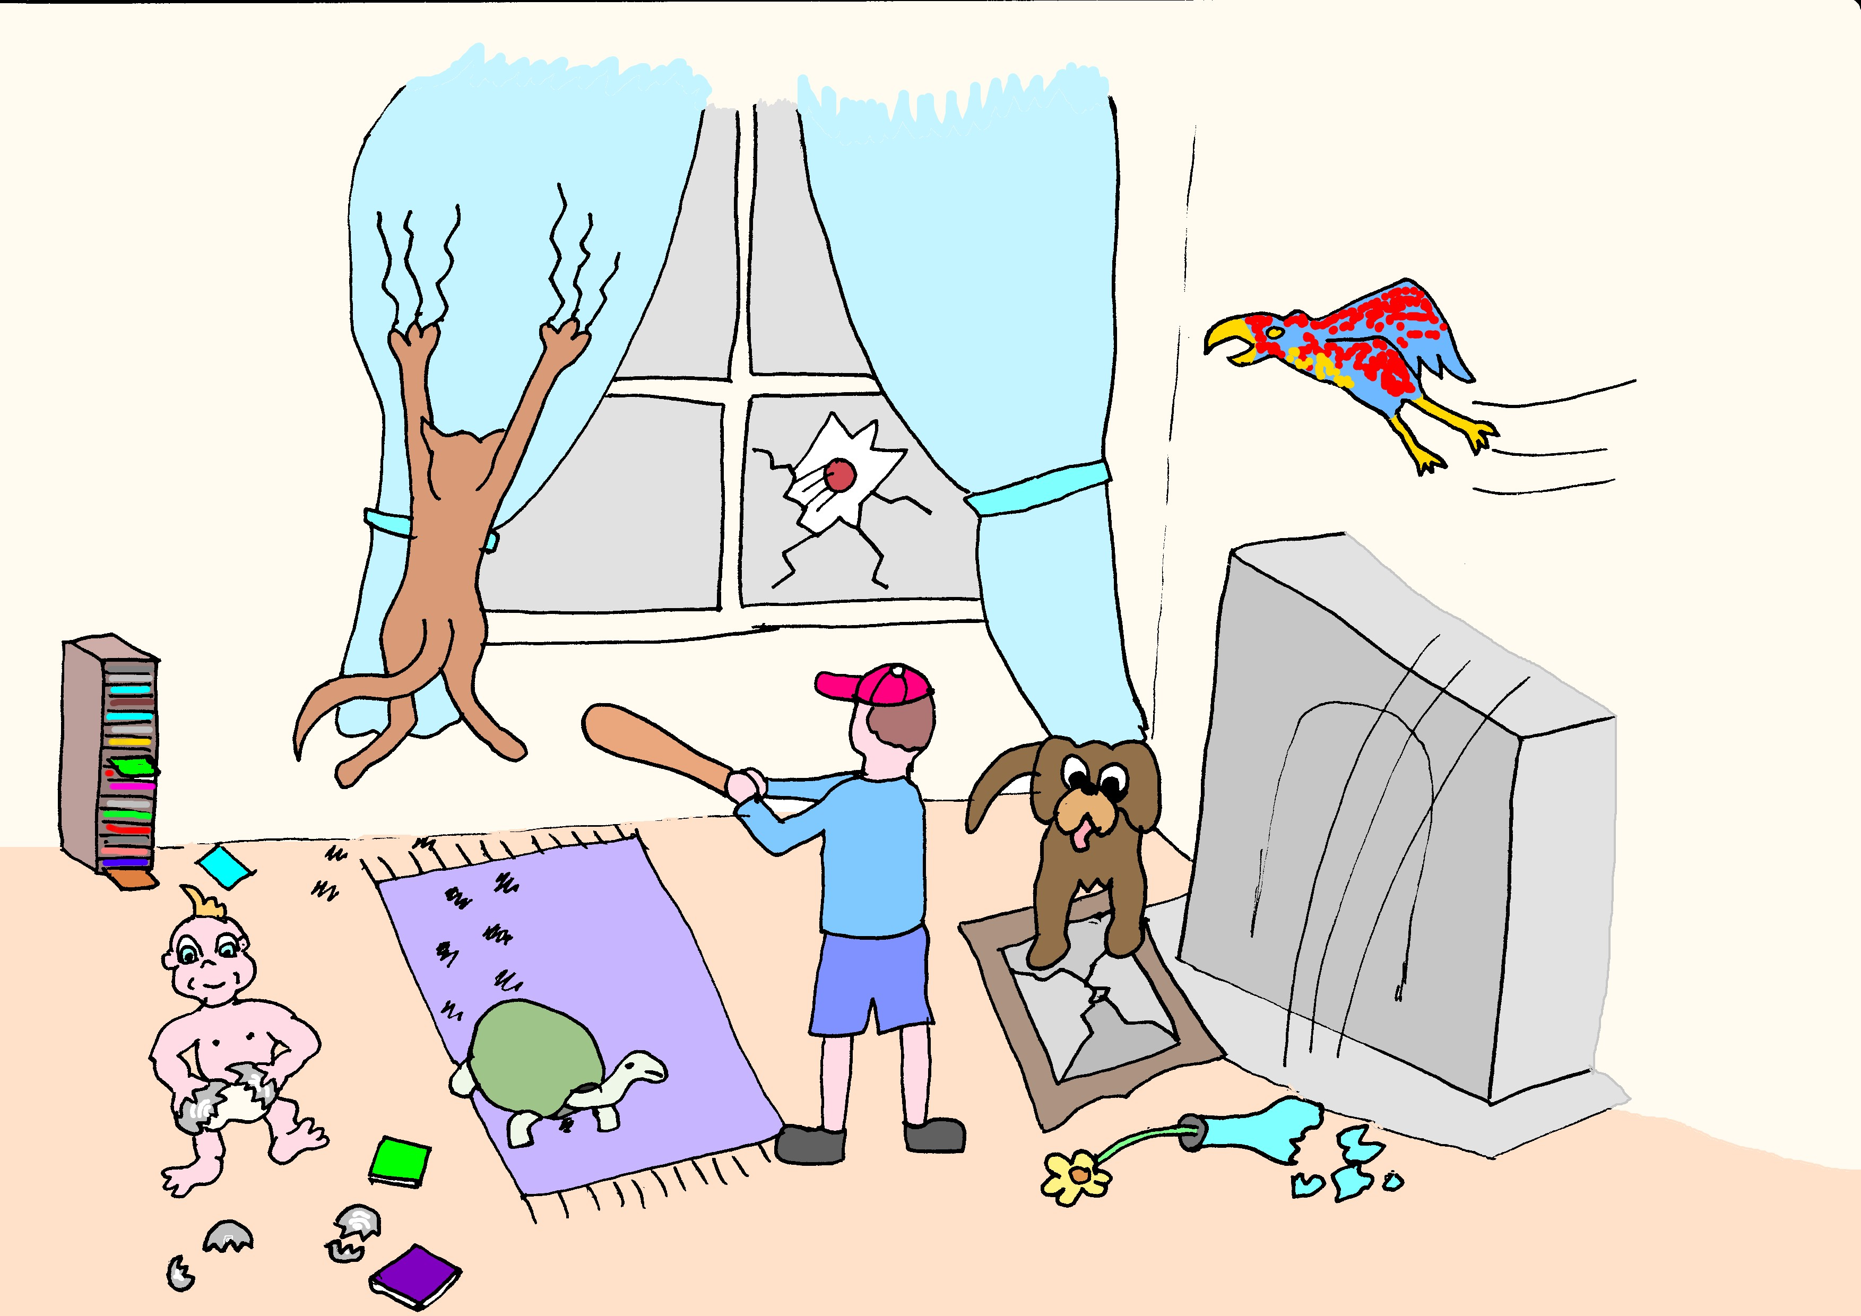
11 - Construction Grammar
Nick Riches
Homework
Probs with trad accs
Val.Aug.
Weird Them.rels
A solution
Goldberg’s theory Valency aug Weird them.rels
Combination
Fusion Trad roles
Implications
Words and rules account Construction Grammar
Other constructions
Comparing the two models
Comparison
Probs for CG
Clin Imps
Bibliography
33 / 34

Slide 50
11 - Construction Grammar
Homework
Problems with traditional Verb Argument Structure accounts
Nick Riches
Homework
Probs with trad accs
Val.Aug.
Weird Them.rels
How constructions solve these issues How constructions combine with verbs The implications of VAS constructions
A solution
Goldberg’s theory Valency aug Weird them.rels
Combination
Fusion Trad roles
Other types of construction (not VAS)
Implications
Words and rules account Construction Grammar
Comparing the two models
Other constructions
Problems for construction grammar
Comparing the two models
Comparison
Clinical implications
Bibliography
Probs for CG
Clin Imps
Bibliography
33 / 34

Slide 51
11 - Construction Grammar
Nick Riches
Homework
Probs with trad accs
Val.Aug.
Weird Them.rels
Goldberg, A. E. (1995). Constructions: a Construction Grammar approach to argument structure. University of Chicago Press.
Riches, N. G. (2013). Treating the passive in children with specific language impairment: A usage-based approach.
Child Language Teaching and Therapy, 29(2), 155–169.
A solution
Goldberg’s theory Valency aug Weird them.rels
Combination
Fusion Trad roles
Implications
Words and rules account Construction Grammar
Other constructions
Comparing the two models
Comparison
Probs for CG
Clin Imps
Bibliography
34 / 34

